Slide 1


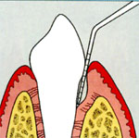
RUNGTA COLLEGE OF DENTAL SCIENCES AND RESEARCH,BHILAI
PERIODONTAL POCKET
Dr PUSHPENDRA
Sr Lecturer
Dept of Periodontology

Slide 2
SPECIFIC LEARNING OBJECTIVES
CORE AREAS | DOMAN | CATEGORY
Introduction | Affective | Desire to know
Definition | Cognitive | Must to know
Classification | Cognitive | Must to know
Clinical features | Cognitive | Must to know
Pathogenesis | Cognitive | Must to know
Histopathology | Cognitive | Must to know
Surface morphology of tooth wall | Cognitive | Must to know
Periodontal disease activity | Cognitive | Must to know

Slide 3
CORE AREAS | DOMAN | CATEGORY
Diagnosis | Cognitive | Must to know
Treatment | Pshycomotor | Nice to know

Slide 4

CONTENTS
PART -I
INTRODUCTION
DEFINITION
CLASSIFICATION
CLINICAL FEATURES
PATHOGENESIS
PERIODONTAL DISEASE ACTIVITY
SUMMARY
REFERENCES

Slide 5

INTRODUCTION

Slide 6
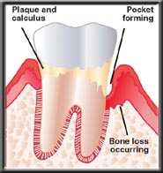
All inflammatory periodontal diseases result in pathological changes in the periodontal tissues, some of which are reversible, while others lead to a loss of integrity of the epithelium and loss of bone and connective tissue support for the tooth.

Slide 7
Periodontal pocket is defined as a pathologically deepened gingival sulcus.
Carranza, 10th edition

Slide 8
CLASSIFICATION

Slide 9
Pockets
Gingival pocket (pseudopocket)
Periodontal pocket
Suprabony pocket
Intrabony pocket

Slide 10
Gingival pocket (also called “peudo-pocket”) is formed by gingival enlargement without destruction of the underlying periodontal tissues.

Slide 11
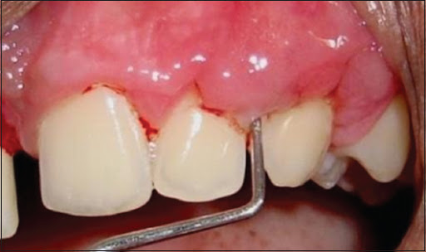
The sulcus is deepened because of the increased bulk of the gingiva.

Slide 12
Periodontal pocket produces destruction of the supporting periodontal tissues, thereby leading to the loosening and exfoliation of the teeth

Slide 13
Based on the location of the base of the pocket in relation to the underlying bone
Suprabony (supracrestal or supraalveolar) occurs when the bottom of the pocket is coronal to the underlying alveolar bone

Slide 14
Intrabony (infrabony, subcrestal, or intraalveolar) occurs when the bottom of the pocket is apical to the level of the adjacent alveolar bone.
With this second type, the lateral pocket wall lies between the tooth surface and the alveolar bone.

Slide 15
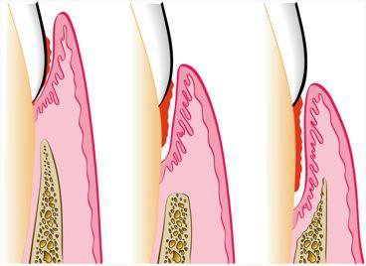
Gingival pocket
Suprabony pocket
Intrabony pocket

Slide 16
SUPRABONY POCKET | INTRABONY POCKET
Base of pocket is coronal to level of alveolar bone. | Base of pocket is apical to crest of alveolar bone so that the bone is adjacent to soft tissue wall.
Pattern of destruction of underlying bone is horizontal | Pattern of bone destruction is vertical (angular)

Slide 17
SUPRABONY POCKET | INTRABONY POCKET
Interproximally, transseptal fibers that are restored during progressive periodontal disease are arranged horizontally in the space between base of pocket and alveolar bone | Interproximally, transseptal fibers are oblique rather than horizontal. They extend from cementum beneath base of pocket along alveolar bone and over crest to cementum of adjacent tooth

Slide 18
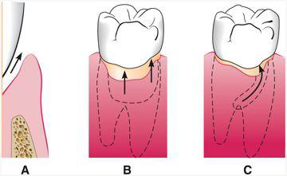
According to pocket surfaces involved:
Simple
Compound
Complex
Pockets can also be SPIRAL (i.e., originating on one tooth surface and twisting around the tooth to involve one or more additional surfaces). These types of pockets are most common in furcation areas.

Slide 19
Simple, when only one tooth surface is involved.
Compound, when two or more surfaces are involved.

Slide 20
CLINICAL FEATURES

Slide 21
SIGNS
Enlarged bluish-red marginal gingiva with rolled-out edge separated from the tooth surface
Reddish-blue vertical zone from the gingival margin to attached gingiva/alveolar mucosa
Break in faciolingual continuity of interdental gingiva
Shiny discolored puffy gingiva

Slide 22
Gingival bleeding
Purulent exudate from the gingival margin in response to digital pressure
Looseness, extrusion, and migration of teeth
Development of diastema where none had previously existed

Slide 23
SYMPTOMS
Localized pain or sensation of pressure after eating, which gradually diminishes
Foul taste in localized areas
Tendency to suck material in the interdental areas
Radiating pain deep in the bone

Slide 24
Gnawing feeling or itching in the gingiva and urge to dig a pointed instrument into the gums and relief obtained from resultant bleeding
Food sticks in between the teeth or teeth feel loose
Sensitivity to heat and cold
Toothache in absence of caries.

Slide 25
PATHOGENESIS

Slide 26
Pocket formation starts as an inflammatory change in the connective tissue wall of the gingival sulcus.
The cellular and fluid inflammatory exudate causes degeneration of the surrounding connective tissue, including the gingival fibers.
Just apical to the junctional epithelium, collagen fibers are destroyed, and the area is occupied by inflammatory cells and edema

Slide 27
The two mechanisms associated with collagen loss are as follows
(1) collagenases and other enzymes secreted by various cells in healthy and inflamed tissue, such as fibroblasts, PMNs, and macrophages, become extracellular and destroy collagen (these enzymes that degrade collagen and other matrix macromolecules into small peptides are called matrix metalloproteinases);

Slide 28
(2) Fibroblasts phagocytize collagen fibers by extending cytoplasmic processes to the ligament–cementum interface and degrade the inserted collagen fibrils and the fibrils of the cementum matrix.

Slide 29
As a result of inflammation, PMNs invade the coronal end of the junctional epithelium in increasing numbers.
The PMNs are not joined to one another or to the epithelial cells by desmosomes

Slide 30
When the relative volume of PMNs reaches approximately 60% or more of the junctional epithelium, the tissue loses cohesiveness and detaches from the tooth surface.
Thus the sulcus bottom shifts apically, and the oral sulcular epithelium occupies a gradually increasing portion of the sulcular (pocket) lining.

Slide 31
Extension of the junctional epithelium along the root requires the presence of healthy epithelial cells.
Marked degeneration or necrosis of the junctional epithelium impairs rather than accelerates pocket formation. (This occurs in necrotizing ulcerative gingivitis, which results in an ulcer rather than pocket formation.)

Slide 32
The transformation of a gingival sulcus into a periodontal pocket creates an area in which plaque removal becomes impossible and a feedback mechanism is established.
The rationale for pocket reduction is based on the need to eliminate areas of plaque accumulation

Slide 33
POCKET CONTENTS
Periodontal pockets contain
debris consisting principally of microorganisms and their products (enzymes, endotoxins, and other metabolic products),
gingival fluid,
food remnants,
salivary mucin,
desquamated epithelial cells, and leukocytes.

Slide 34
Purulent exudate, if present, consists of living, degenerated, and necrotic leukocytes; living and dead bacteria; serum; and a scant amount of fibrin.

Slide 35
Significance of Pus Formation
Pus is a common feature of periodontal disease, but it is only a secondary sign.
The presence of pus or the ease with which it can be expressed from the pocket merely reflects the nature of the inflammatory changes in the pocket wall.

Slide 36
It is not an indication of the depth of the pocket or the severity of the destruction of the supporting tissues.
Extensive pus formation may occur in shallow pockets, whereas deep pockets may exhibit little or no pus

Slide 37
PERIODONTAL DISEASE ACTIVITY

Slide 38
Two theories
"linear" (continuous-rate) model
Overall sites slowly and progressively lose attachment
"burst" (random) model
multiple sites show breakdown within a short period, with periods of remission that might last for months, years, or decades.

Slide 39
linear" (continuous-rate) model
There are 4 lines of evidence which suggest that the model of continuous destructive periodontal disease is incorrect.
The attachment loss rates which are too fast or too slow to be consistent with the observed loss of attachment in individual subjects

Slide 40
2. The large number of sites (with or without prior attachment loss) which do not appear to be changing seem inconsistent with the view of a slowly progressive destructive periodontal disease.

Slide 41
"burst" (random) model
Periods of quiescence are characterized by a reduced inflammatory response and little or no loss of bone and connective tissue attachment.

Slide 42
A buildup of unattached plaque, with its gram-negative bacteria, starts a period of exacerbation in which bone and connective tissue attachment are lost and the pocket deepens

Slide 43
This period may last for days, weeks, or months and is eventually followed by a period of remission or quiescence in which gram-positive bacteria proliferate and a more stable condition is established

Slide 44
These periods of quiescence and exacerbation are also known as periods of inactivity and periods of activity.
Clinically, active periods show bleeding, either spontaneously or with probing, and greater amounts of gingival exudate.

Slide 45
SUMMARY
1) Although periodontal pocket formation/periodontitis is a pathologic process, and the host response that causes the tissue destruction, is aimed to restrict the spreading of the infection into deeper areas.
2) Despite of a huge number of studies on periodontitis development, we still do not have a clear picture of the crucial events leading to the periodontal tissue destruction.

Slide 46
REFERENCES
Newman M, Takei H, Klokkevold P, Carranza F. Clinical Periodontology. 10th ed. W.B. Saunders; 2006.
2) Lindhe J, Lang NP and Karring T. Clinical Periodontology and Implant Dentistry. 6th ed. Oxford (UK): Blackwell Publishing Ltd.; 2015.
3) Newman MG, Takei HH, Klokkevold PR, Carranza FA. Carranza’s clinical periodontology, 13th ed. Saunders Elsevier; 2018.

Slide 47


